Slide 1
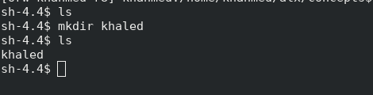
What is the shell
the shell is a way for you to talk to your computer using text commands, allowing you to control and manage your computer efficiently
a program that acts as an interface between the user and the operating system.

Slide 2
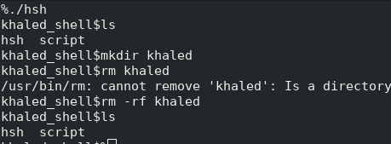
Two modes of shell
Interactive Mode:
Description: User interacts with the shell one command at a time, and see the output immediately , also the shell display a prompt.

Slide 3
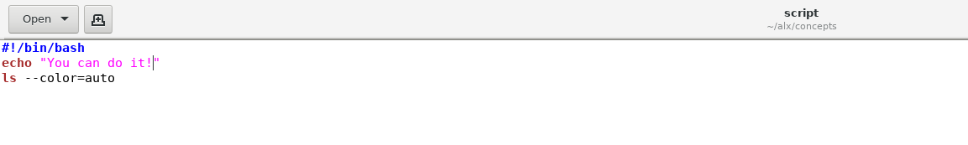
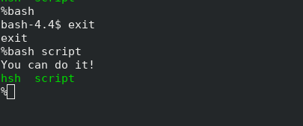
Two modes of shell
Non-Interactive Mode(A):
Description: User provides a sequence of commands in a script file, so the shell executes all commands , and produce the output , no need to display prompt. This mode is often used for running scripts or automated tasks.

Slide 4

Two modes of shell
Non-Interactive Mode(B):
Description: Input to shell program comes from output of another pipe(let us call command now) i.e your shell program is not connected directly to terminal, so also no need to display prompt. Used when a command is part of a pipeline.

Slide 5
How to know which mode?
if the input stream is connected to a terminal helps determine if the program is running interactively. Let us first revisit quickly the concept of file descriptors: File Descriptor:
Number representing an open file or input/output stream in a program.
Standard Input (stdin):
File descriptor (number 0) representing the default input stream for a program.
Used for reading input from the user or other programs.
Standard Output (stdout):
File descriptor (number 1) representing the default output stream for a program.
Used for writing normal program output.
Standard Error (stderr):
File descriptor (number 2) representing the default error output stream for a program.
Used for writing error messages or diagnostic information.

Slide 6
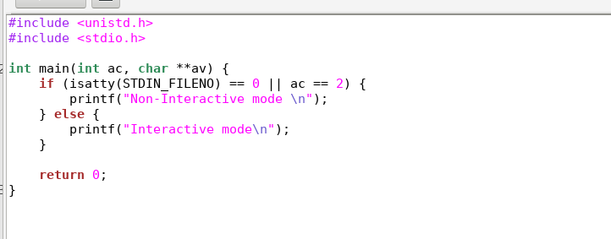
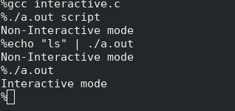
How to know which mode?
To detect interactive mode , we should check if input to program comes from user or not i.e if input stream to our program is connected to terminal or not➔we have The isatty function returns 1 if the file descriptor is associated with a terminal, and 0 otherwise.
To detect non-interactive mode(A), briefly script file is passed as argument to program, so if number of arguments passed to main function >= 2, you are in non-interactive mode , passing script to your shell program.
Else mode(B) in non-interactive mode(B)

Slide 7
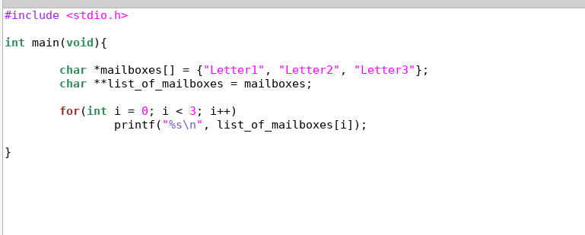

Char **
in Brief:
Represents a pointer to a pointer to a character.
Commonly used for handling arrays of strings.
Imagining it: list of mailboxes. Each mailbox has its own address. The list itself is like a big mailbox, and each element in the list points to a specific mailbox.
Example: Used to manage arrays of strings in C programming.

Slide 8
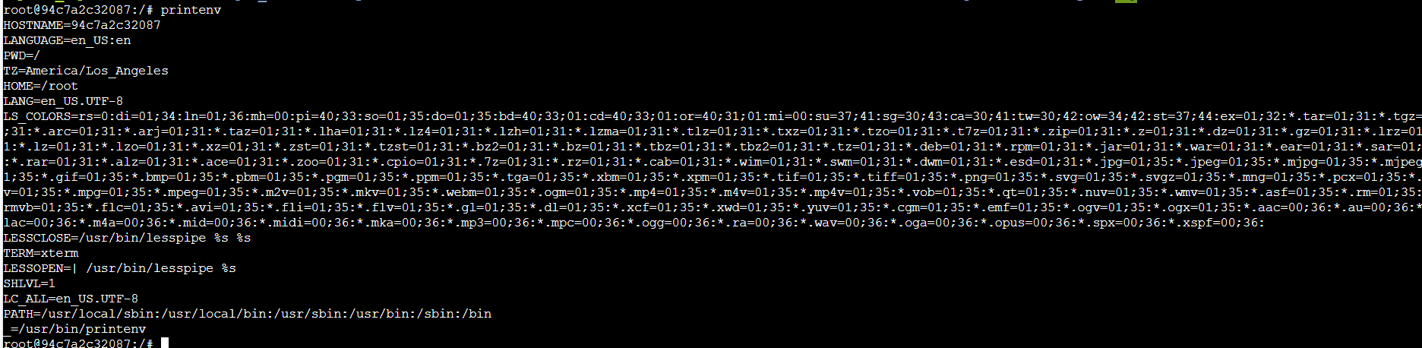
Environmental variables
environment variables are like global settings that programs can use to customize their behavior or access important information about the system or user preferences.
my env vars on my machine:

Slide 9
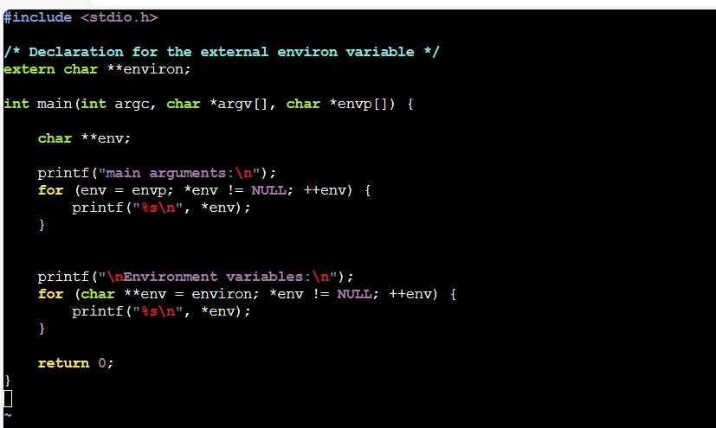
Environmental variables
Can we get all env vars in our program?➔Yes we can there are 2 methods, one of them through our main function(3rd prototype):

Slide 10
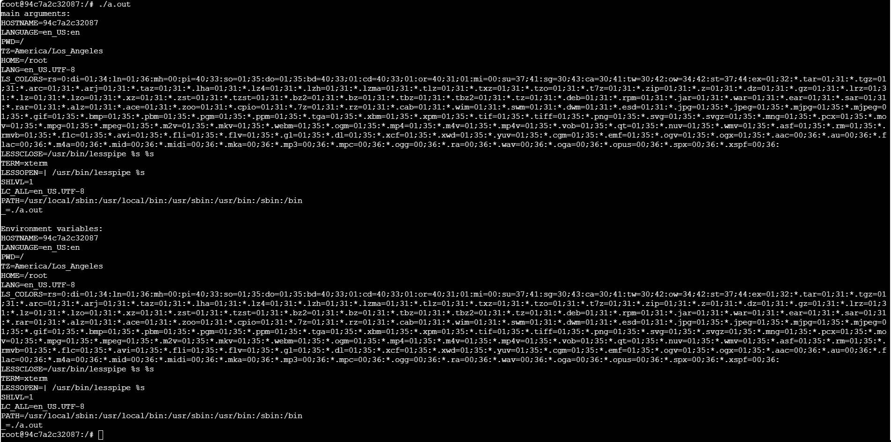
Environmental variables

Slide 11
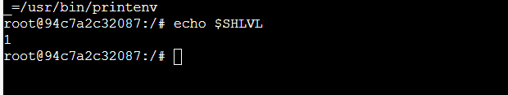
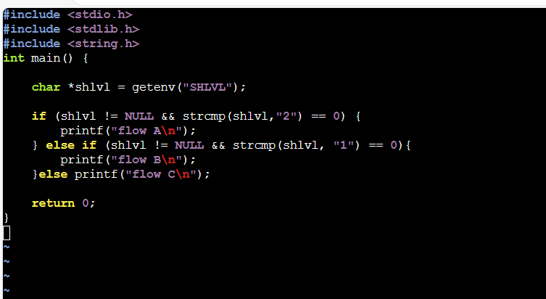

Environmental variables
To show for example value of SHLVL:
How to get value of SHLVL in your C program:

Slide 12

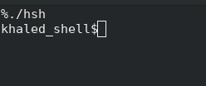


What is process?
Running instance of a computer program.
Created by the operating system when a program is executed.
Independent entity with its own memory and resources.
Processes allow multiple programs to run simultaneously without interfering with each other.
For every process there is a unique id, and it have a parent process
you can create a process from inside of another process. In 3 different terminals sessions on the same machine do that exercise:
run instance of program your own shell ./hsh
Run another instance of it ./hsh
Run bash shell: bash 3 different process are created:

Slide 13
EXECVE
.
What is execve?
execve is like a special command that lets your program switch into another program.
What does it do?
It replaces the current program with a completely different one.
Inputs to execve:
Path to the Executable (pathname):
Imagine it as the full address to the program you want to run.
Command-Line Arguments (argv):
These are like instructions you want to give to the new program. The first one argv[0] is usually the program’s name.
Example: If you're running ls -l, "ls" is the program name(argv[0]), and "-l“(argv[1]) is an argument.
Environment Variables (envp):
Additional settings for the new program., providing information such as the location of your home directory or specifying directories for it to search
It’s like telling the program, "Please recognize my home as /home/user."
Why Use execve?
Sometimes, your program wants to do something it can't do alone, so it calls in a specialist (another program) using execve. It's like hiring someone to do a specific job

Slide 14
EXECVE
.
Steps:
Load New Program:
Operating system loads the new program into memory.
Replace Memory Contents:
Memory contents are replaced with the new program's contents.
Start Execution:
New program starts executing from its main function.
Arguments and Environment:
Command-line arguments and environment variables are passed to the new program.
Process Image Transformation:
Current process becomes the new program.
Return on Success:
If successful, execve doesn't return; new program continues.
Return on Failure:
If there's an error, execve returns -1; original program continues.

Slide 15
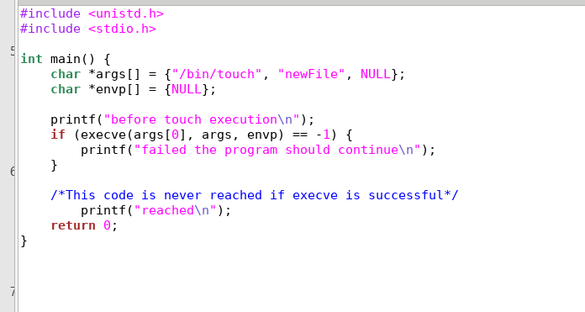
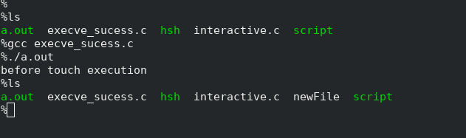
EXECVE
.
int execve(const char *pathname, char *const argv[], char *const envp[]);
Success:

Slide 16
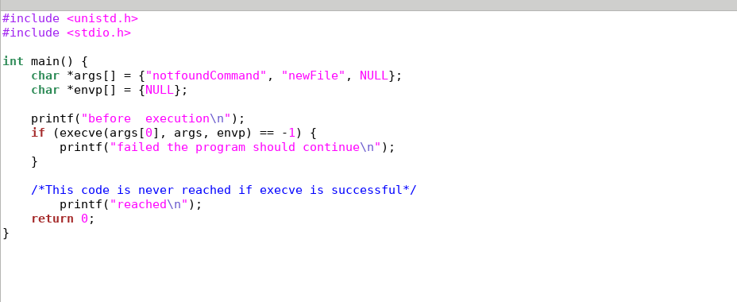
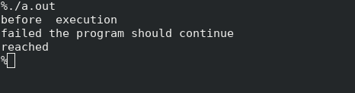
EXECVE
.
int execve(const char *pathname, char *const argv[], char *const envp[]);
Failure

Slide 17
How to create process in C?
➔use fork system call:
Steps when fork() is Called:
fork() creates a copy of the existing process.
Two Processes: Both the original (parent) and the new (child) processes start executing from the line following the fork() call. (you need to differentiate what to do after fork() but how? ➔Return values)
Return Values:
In the parent process, fork() returns the child's process ID (PID).
In the child process, fork() returns 0.
Independent Execution:
Parent and child processes operate independently with their own memory space(this is the idea of processes).
Concurrent Execution:
Enables concurrent execution of code in both the parent and child processes.

Slide 18
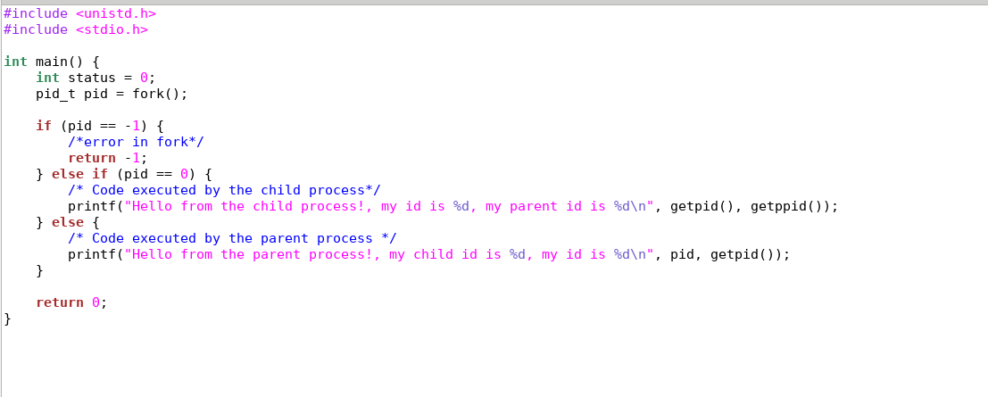


Slide 19
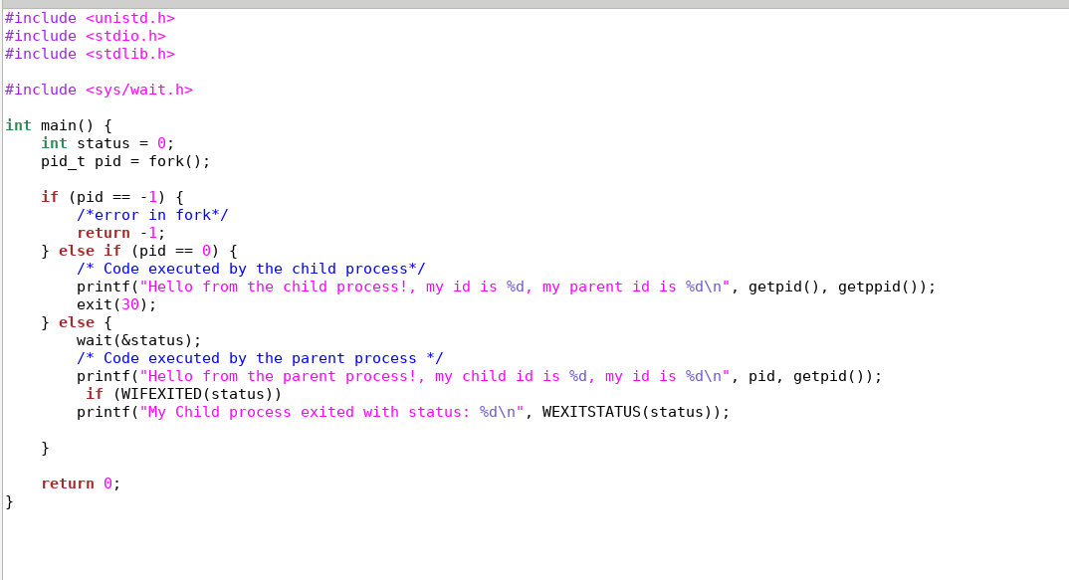
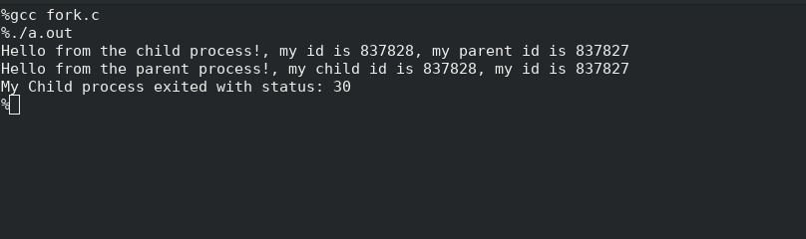
wait
wait function is used to make a process wait until one of its child processes terminates

Slide 20
But why we need to create process in our c code for shell?????
Any one know!!

Slide 21
But why we need to create process in our c code for shell?
You want for example to execute /bin/ls , and then continue taking commands from user in case of interactive or from file/another command in case of non-interactive, the idea here you will execute /bin/ls through our hire execve and if it succeded then your main program will not continue, so we will be executing /bin/ls in another process

Slide 22
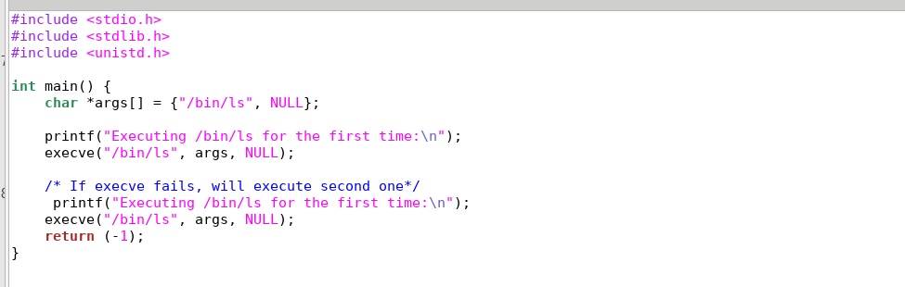
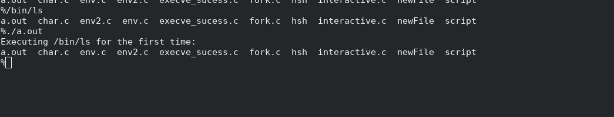
Program without fork to execute 2 /bin/ls

Slide 23
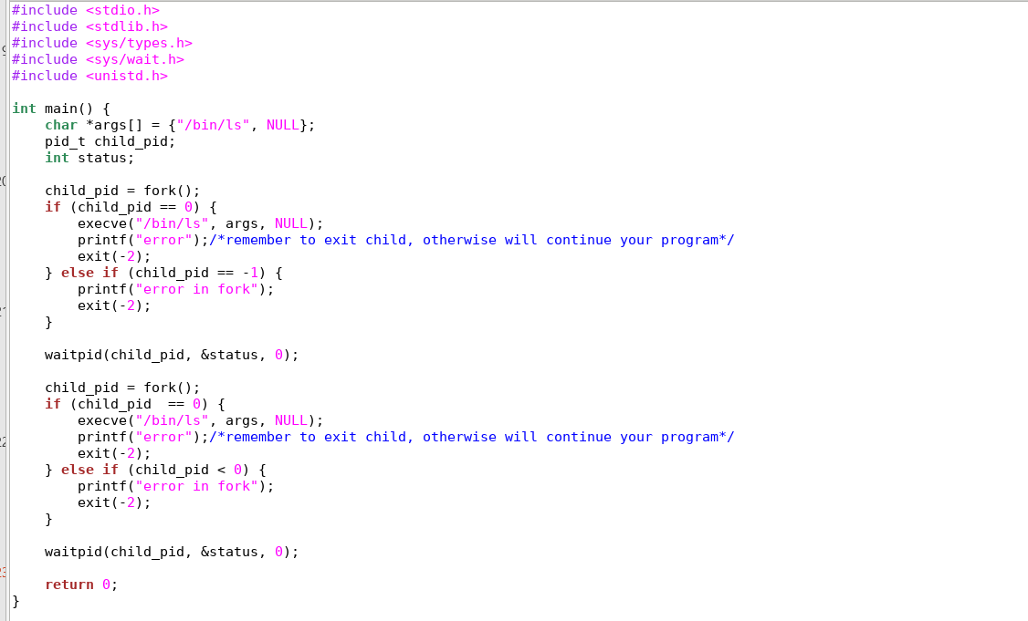
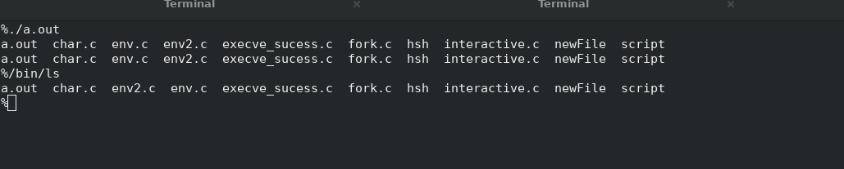
Program with fork to execute 2 /bin/ls
Remember to exit your child in case of failures

Slide 24
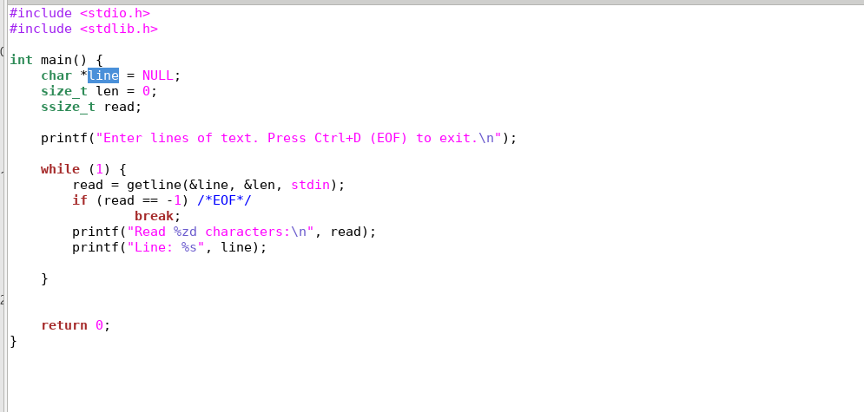
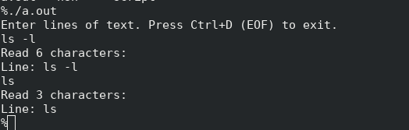
How to read input?
ssize_t getline(char **lineptr, size_t *n, FILE *stream);

Slide 25
There is a problem here can you spot it? Also there is a hint here can you give it to us?(think of interactive shell and non-interactive shell mode A)

Slide 26
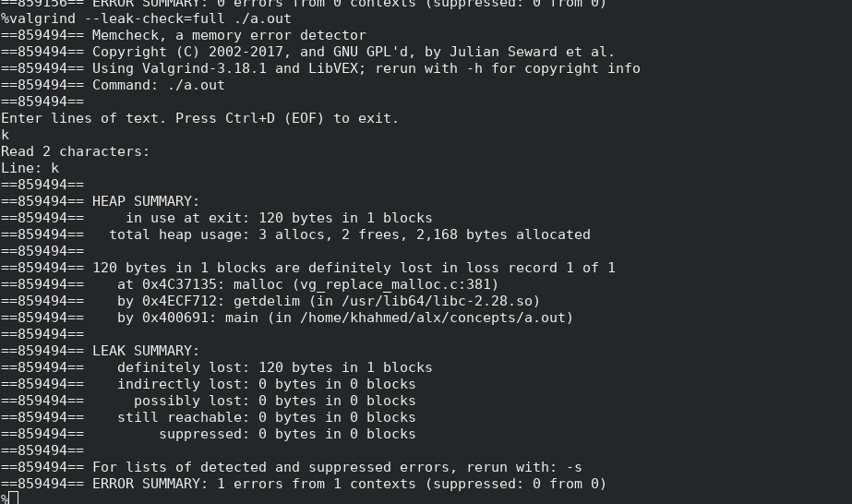
Memory leak, always run valgrind

Slide 27
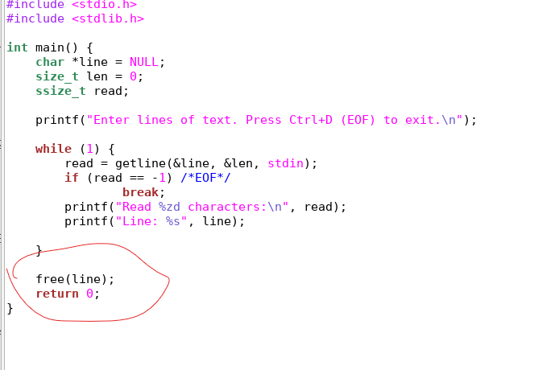
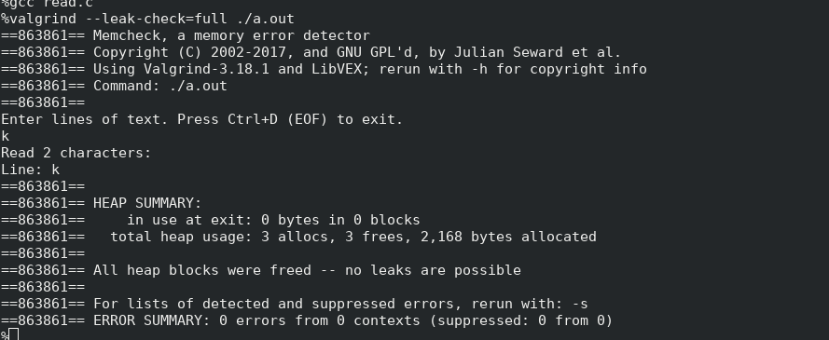
Memory leak, always run valgrind

Slide 28
Hint, in case of non-interactive mode B read from file given in argv[1] instead of stdin.

Slide 29
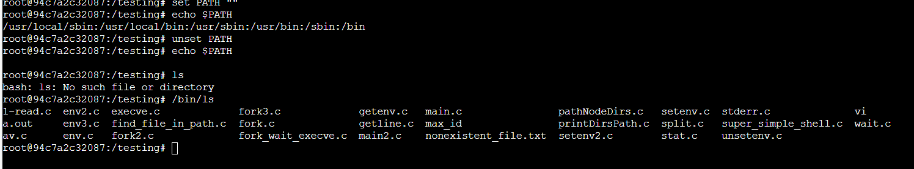
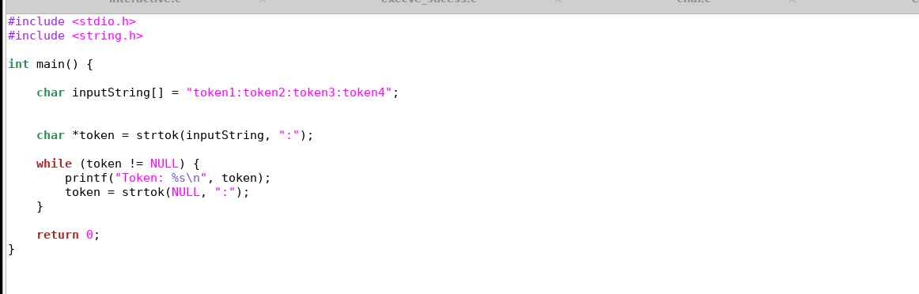
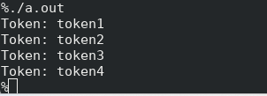
Last 2 things before complete picture: -Env var PATH:
-parsing a string(where to use that in simple shell?):

Slide 30
Time to think together of high level view on Shell? Flow Chart + look on very simple code

